Slide 1
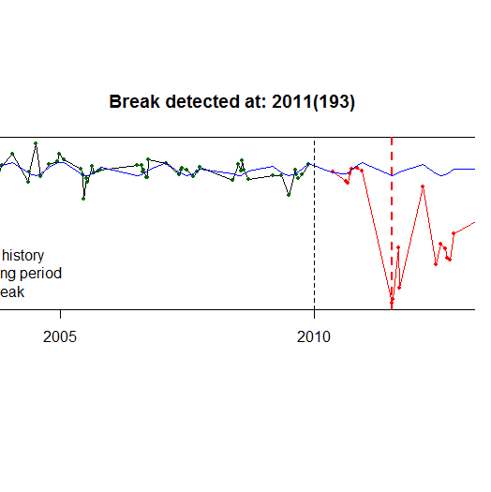
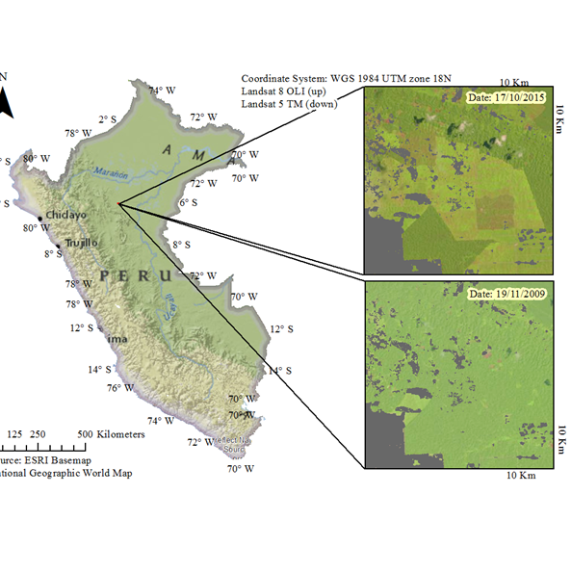
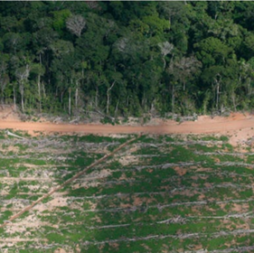
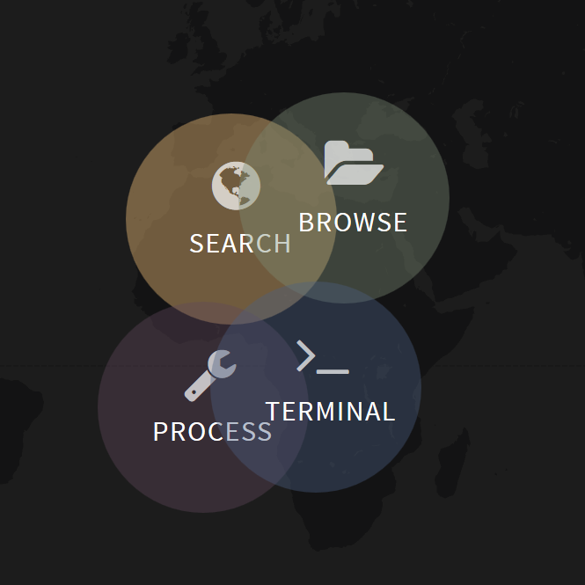
DETECTING CHANGE FROM DENSE TIME-SERIES
BFAST
(Breaks For Additive Season and Trend)
Sabina Roșca
Jan Verbesselt
sabina.rosca@wur.nl
jan.verbesselt@wur.nl

Slide 2
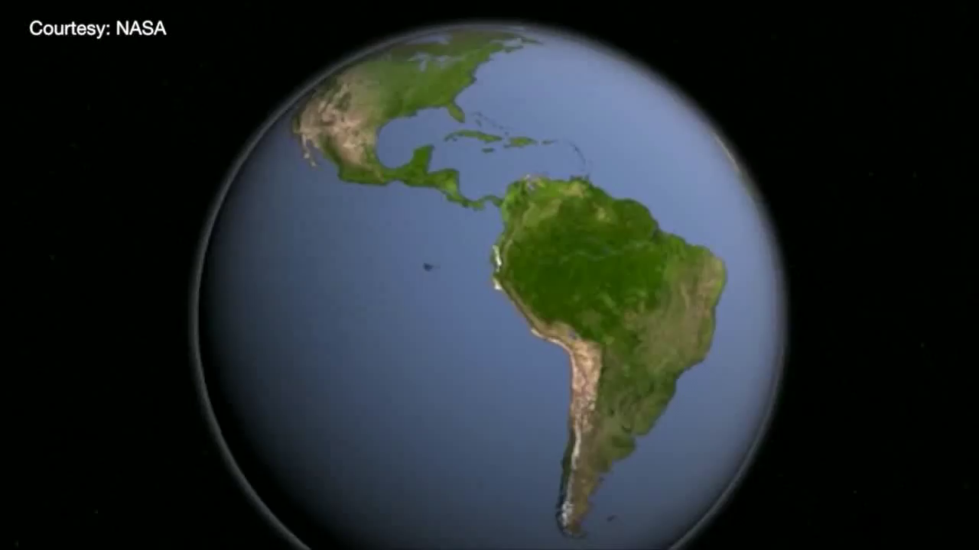
Introduction
"We are the first generation to feel the effect of climate change and the last generation who can do something about it."
President Obama
Forests play a central role in combating climate change
Improve monitoring and quantification of forest loss and forest gain
Why are we interested in time series/time series analysis?
Notes:
Images
Impact
Bigger picture: generic goal

Slide 3
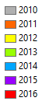
What is BFAST?
Why is Bfast with SEPAL of interest for FAO?
Bfast is an open source tool
Countries can use it themselves, adapting it to their needs

Slide 4
Workshop summary
Goal: Understand how BFAST works and how to properly apply it
PART I Understanding the theory (~1hour)
1. Explaining the algorithm: What are BFAST Monitor and bfastSpatial?
2. Analysis overview: from Landsat scenes to forest change monitoring
3. Discuss and understand the parameters of the bfastSpatial function
Break
PART II Practical (~1 hour)
4. Test bfastSpatial function with different parameters on a prepared dataset
5. Post-processing and exploring results
6. Discuss results and the process of applying the algorithm
7. Discuss the future of BFAST: a faster algorithm for larger AOIs (SciDB)

Slide 5
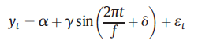
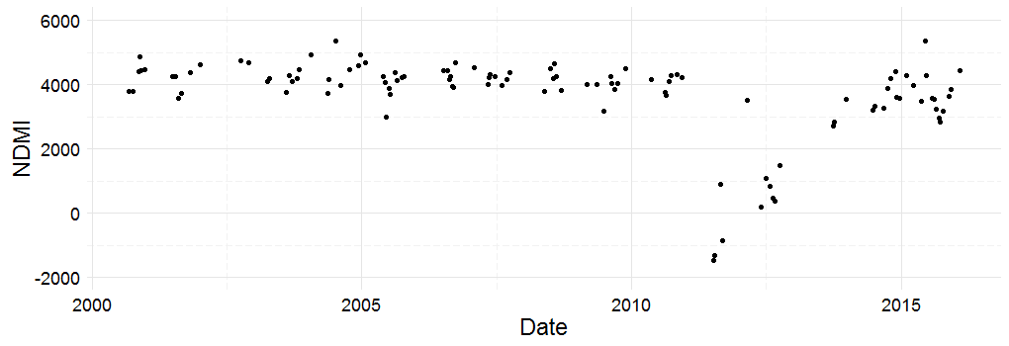
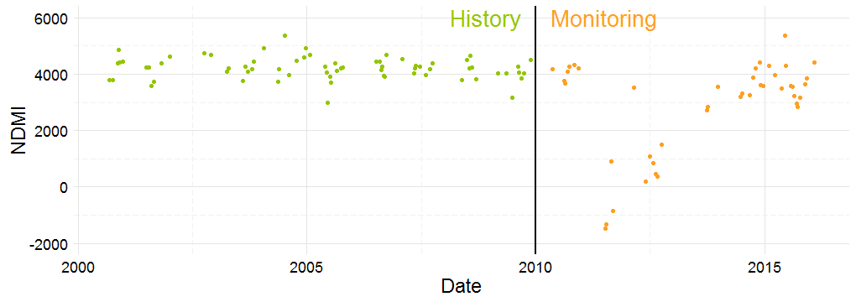
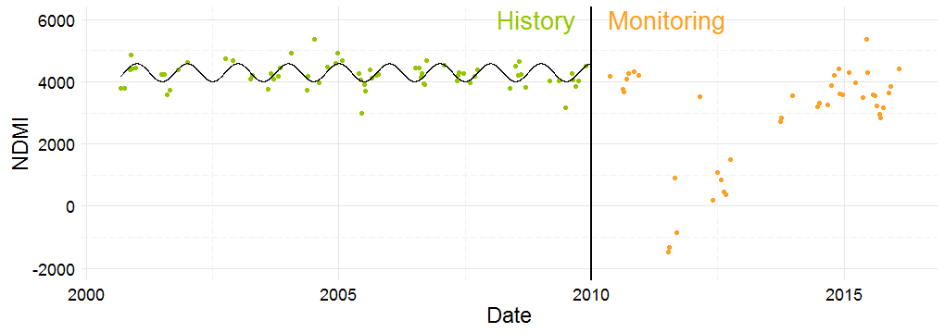
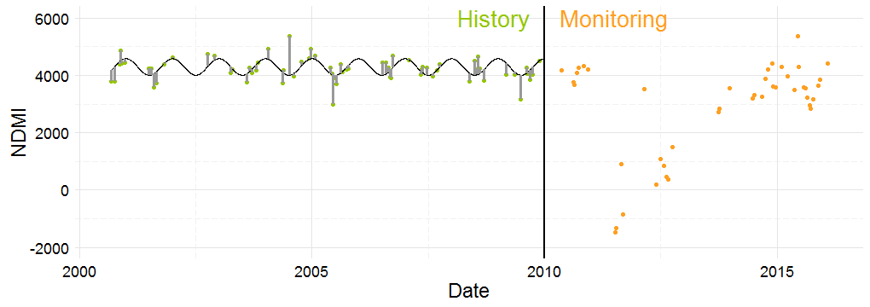
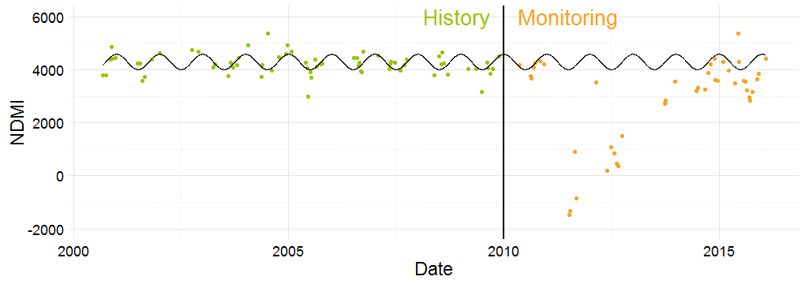
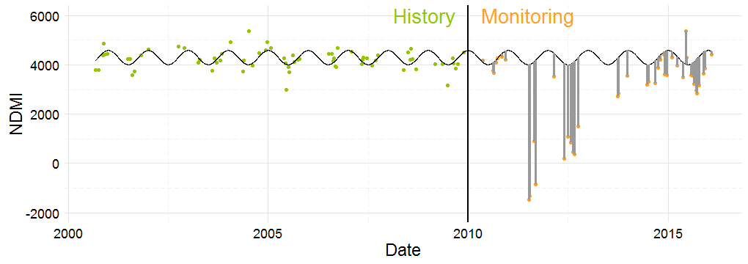
For this, the MOSUM test is applied
BFAST : Breaks For Additive Season and Trend
All observations (NDMI) of one pixel between January 2000 and April 2016.
Total = 111 obs.
The model is projected in the monitoring period
Defined by the user in accordance with the specifications of the project
"Least squares" means that the overall solution minimizes the sum of the squares of the residuals
Family of methods
v
harmonic order 1:
Testing the stability of the model = to check if the „new data” still „fits” the model
If the data still fits => no change is detected
else => a break is marked
combine techniques for break detection with a seasonal-trend model for detecting change in vegetation dynamics.
BFAST Monitor
The method consists in fitting a model to the data by Ordinary Least Squares (OLS) fitting, on a period defined as stable history, and testing for stability of the same model, during a period defined as monitoring period.
The method consists in fitting a model to the data by Ordinary Least Squares (OLS) fitting, on a period defined as stable history, and testing for stability of the same model, during a period defined as monitoring period.
The method consists in fitting a model to the data by Ordinary Least Squares (OLS) fitting, on a period defined as stable history, and testing for stability of the same model, during a period defined as monitoring period.
The method consists in fitting a model to the data by Ordinary Least Squares (OLS) fitting, on a period defined as stable history, and testing for stability of the same model, during a period defined as monitoring period.
The method consists in fitting a model to the data by Ordinary Least Squares (OLS) fitting, on a period defined as stable history, and testing for stability of the same model, during a period defined as monitoring period.
The method consists in fitting a model to the data by Ordinary Least Squares (OLS) fitting, on a period defined as stable history, and testing for stability of the same model, during a period defined as monitoring period.
The method consists in fitting a model to the data by Ordinary Least Squares (OLS) fitting, on a period defined as stable history, and testing for stability of the same model, during a period defined as monitoring period.
Notes:
Modify, erase first paragraph a

Slide 6
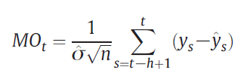
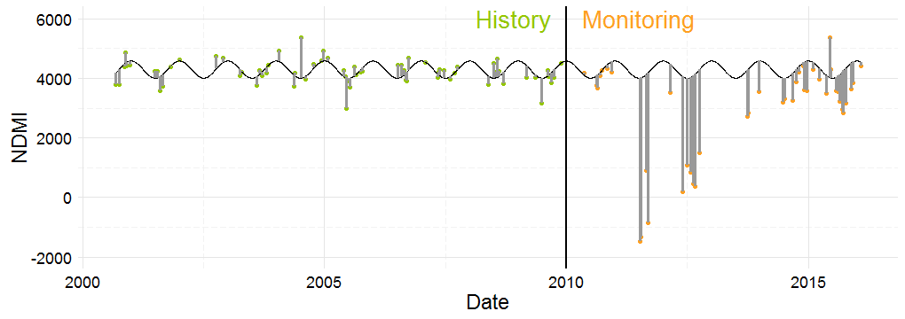
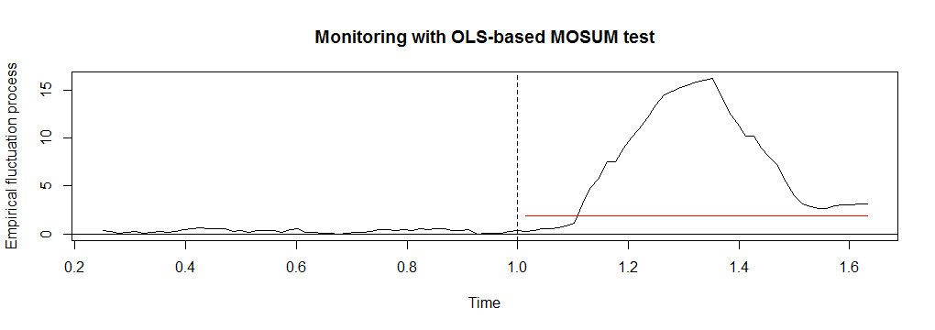
Applying MOSUM
MOSUM detects a break when the MO passes the 95% significance boundary
n=68
h=25% n=17
σ= predicted variance estimated
on the history period
Break detected

Slide 7
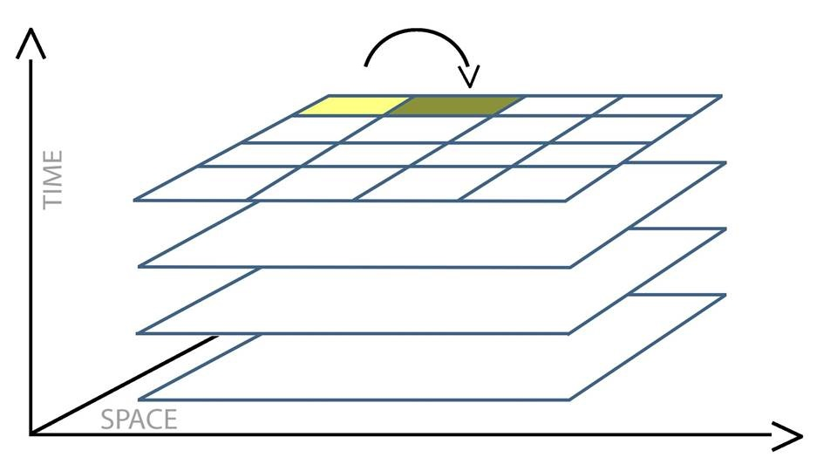
BFAST Spatial
Monitoring period
History period
all individual time series (one pixel) WILL have the same monitoring period
all individual time series (one pixel) CAN have the same history period
each individual time series (one pixel) WILL have the same regression model (ex:harmonic order 1), but different parameters
Change detection is unique for each pixel
Notes:
Insert drawing explaining bfastSpatial

Slide 8
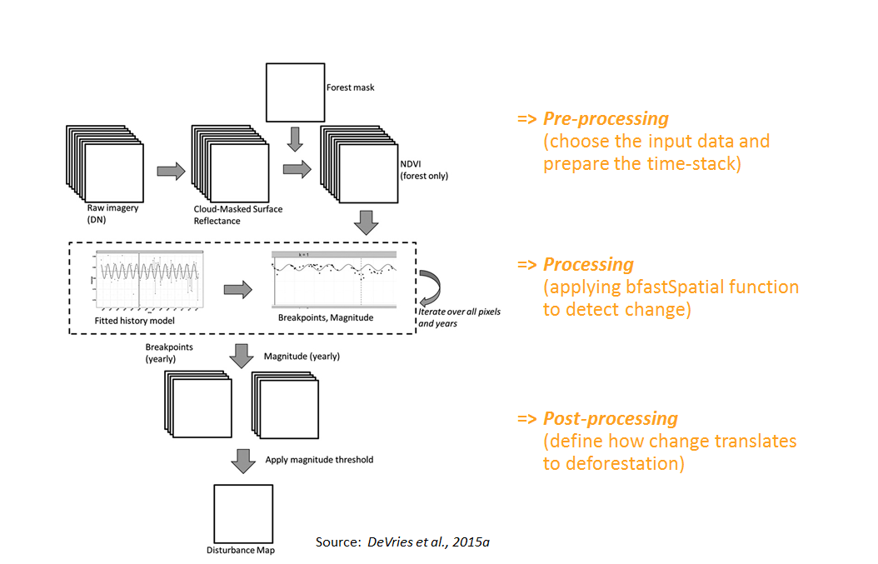
Analysis overview: from Landsat scenes to deforestation detection
Notes:
Add link to Loic’s tutorial and to the Preprocessing r script

Slide 9
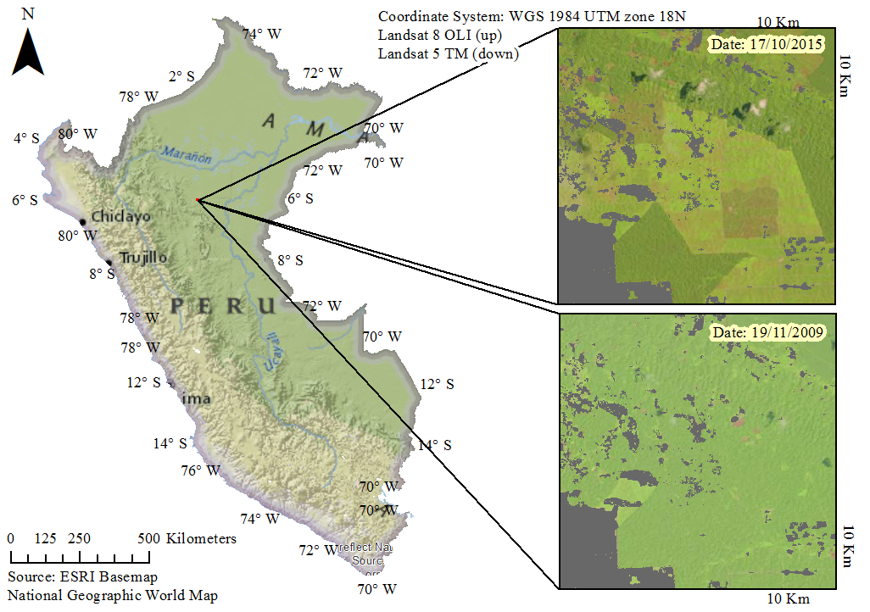
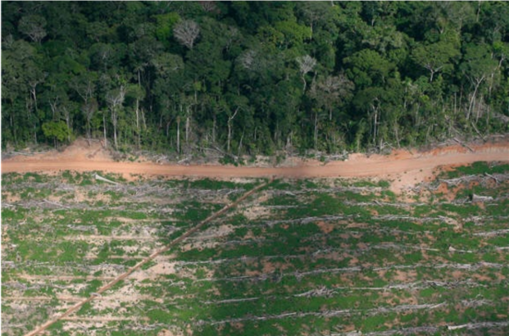
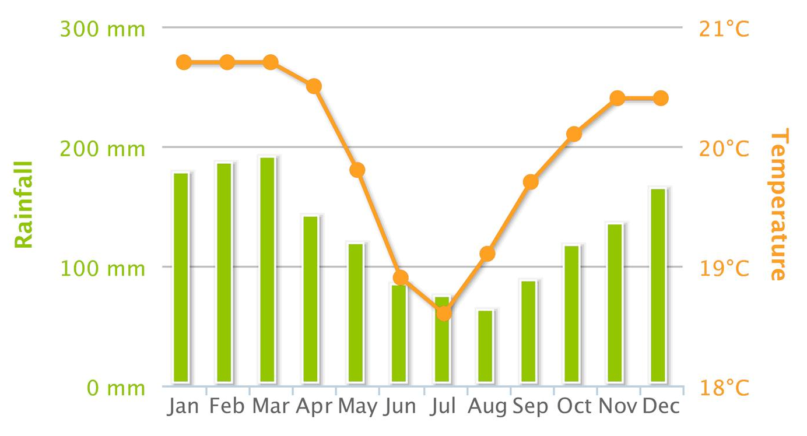




Case study: Peru
Forest Characteristics
Evergreen forest with seasonality: „selva alta”
Loreto is the largest region in Peru and has had more hectares deforested than any other (Peruana, 2015 ”Revealing the hidden”)
Deforestation in large „blocks resulting from agricultural investments (mainly palm oil)
$${\text{Source}\text{: }\text{Barranquita} \text{Resiste}}^{2}$$
$${}_{}^{1}{http://sdwebx.worldbank.org/climateportal/}$$
$${\text{Source}\text{: }Climate change Knowledge Portal}^{1}$$
$${}_{}^{2}{\text{https}\text{://}\text{cordilleraescalera}\text{.}\text{wordpress}\text{.}\text{com}\text{/}\text{bbarranquita}\text{−}\text{resistsb}\text{−2/ }}$$

Slide 10
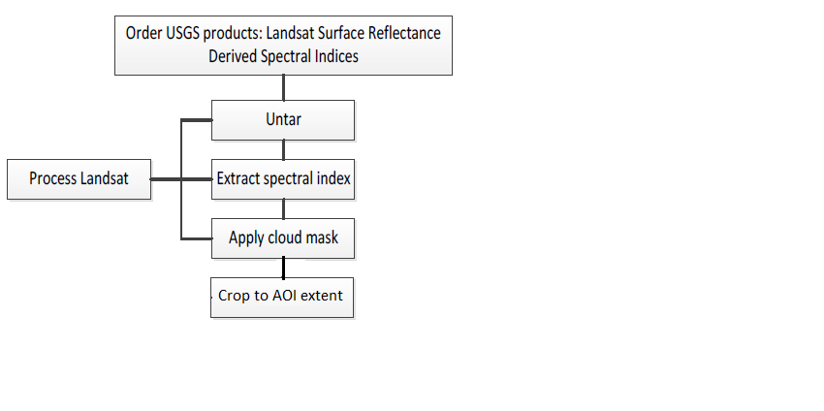
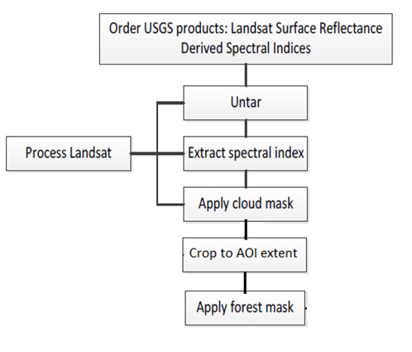
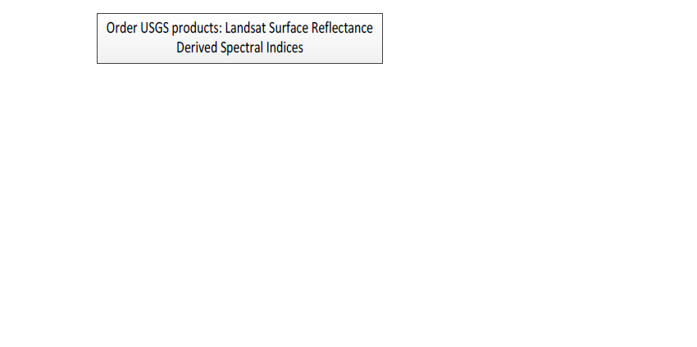
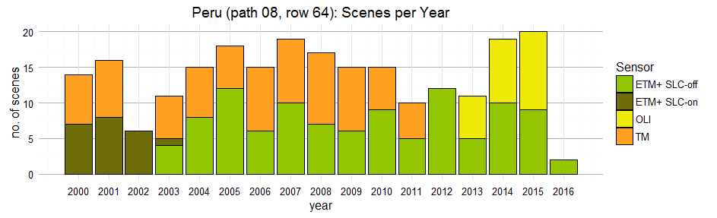
Data acquisition and Pre-processing
Products acquired:
NDVI and NDMI derived from Surface Reflectance products
proccessed and provided by the USGS
Cloud Mask
– computed using unsupervised classification: k-means
Forest Mask (for 2010)
Pre-proccessing
Online tutorial
http://www.loicdutrieux.net/bfastSpatial/
Create time stack
Total scenes: 235

Slide 11
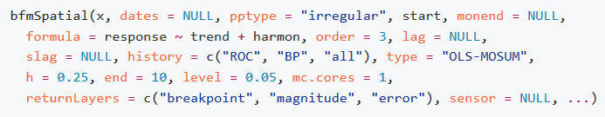
Discuss and understand the parameters of the bfastSpatial function
Guide: https://github.com/rosca002/Testing_BFAST_settings/blob/master/Bfast_Spatial_Guide.md
1. Input data: What vegetation index to use?
Convenient: NDMI or NDVI
Recommended: NDMI

Slide 12
2. History Period
(i) How long should the history period be?
- depends on the regression model
- frequently clouded areas: min 55-60 scenes in the history period
- enough observations per pixel for the algorithm to fit a model (a min of 20 observations per pixel, and a mean of 40-50 observations per pixel)
- the more cloudy the scenes are, the bigger the number of scenes needed.
(ii) How to have a disturbance free history period?
- options: all, ROC
- a moment that delineates a stable period in the history period can be provided by expert knowledge
- or can be calculated automatically using the reverse-order-cumulative sum (ROC or CUSUM) of residuals
- extremely low number of scenes available (due to cloud coverage, e.g. Gabon) it is recommended to use all scenes available in the history period, with the condition to visually assess the study area for disturbances in this period
Notes:
Reduce text

Slide 13

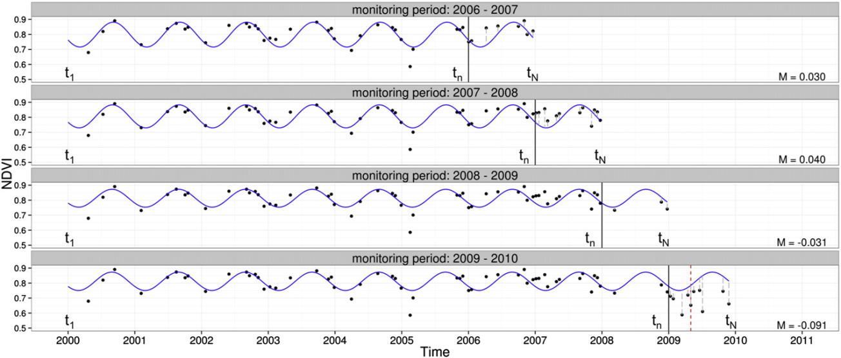
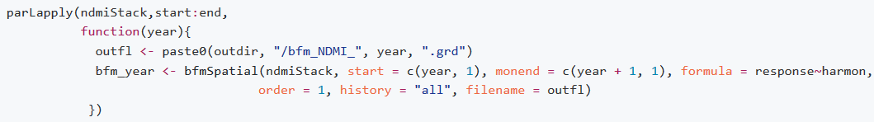
3. Monitoring period
(i) Full monitoring period approach
(ii) Sequential monitoring approach
Limits the monitoring period to one year
the history period is enlarged with every iteration
this approach can make a big difference in the cases with very few observations available
Source: DeVries et al., 2015a

Slide 14
4. Regression model
the phenology of the forest
- choose the harmonic order of the model to follow as closely as possible the seasonal patterns
- decide if trend is, or not, to be included in the model
(ii) the number and frequency of the cloud-free available imagery.
- the more complex the regression, more observations are needed in the history period
- even though present, complex seasonal patterns might not be detectable with Landsat data alone, if the AOI is frequently cloud covered
Notes:
Remove above text, add it in the speach

Slide 15
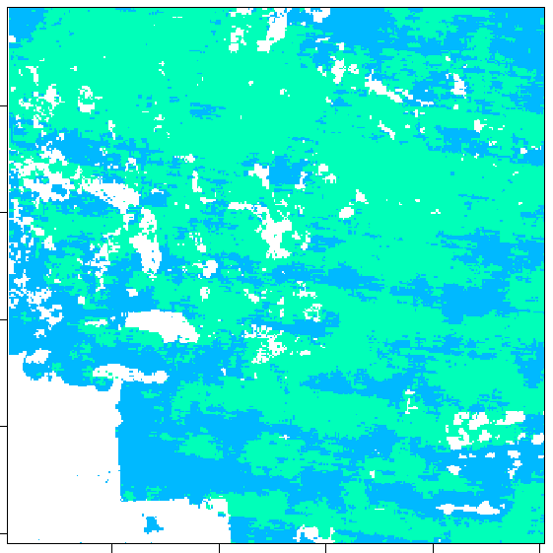
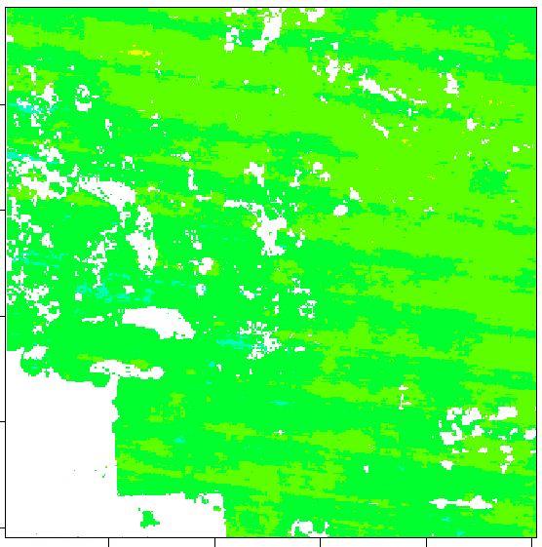
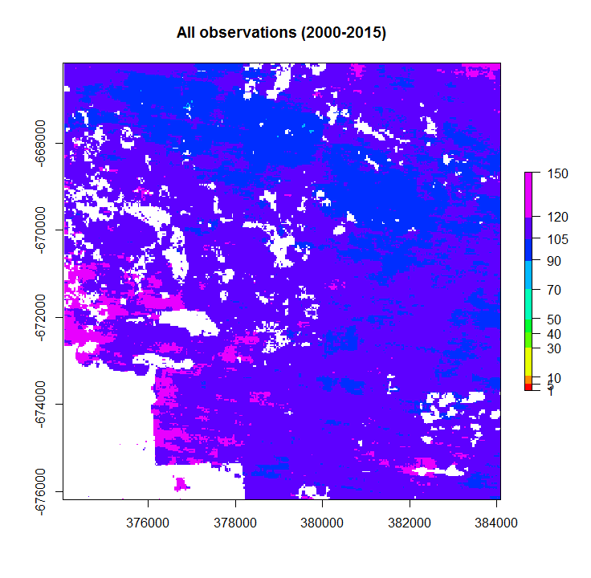

No. Observations per pixel
History period (2000-2010)
Monitoring period (2010-2015)
All observations (2000-2015)
Min: 52
Max: 87
Min: 29
Max: 55
Min: 88
Max: 135
Total scenes: 235
$${\text{Source}\text{: }Climate change Knowledge Portal}^{1}$$

Slide 16

Next: PART II Practical
Break

